Slide 1
MVVM for Mobile And Desktop

Slide 2
Who am I
Passionate developer since age of 8
Microsoft Azure MVP
CEO of sia-consulting limited
Speaker at conferences like DDC and DWX
Cloud and Mobile enthusiast
Current Obsession: GDPR & CLOUD-Act

Slide 3
What is MVVM?
Design Pattern
Model-View-ViewModel
Great for Mobile and Desktop
Used also in Web
MVVM-Frameworks
Prism, MvvmCross, Mvvm Light, etc.
Invented 2005 by Microsoft MVP John Gossman

Slide 4

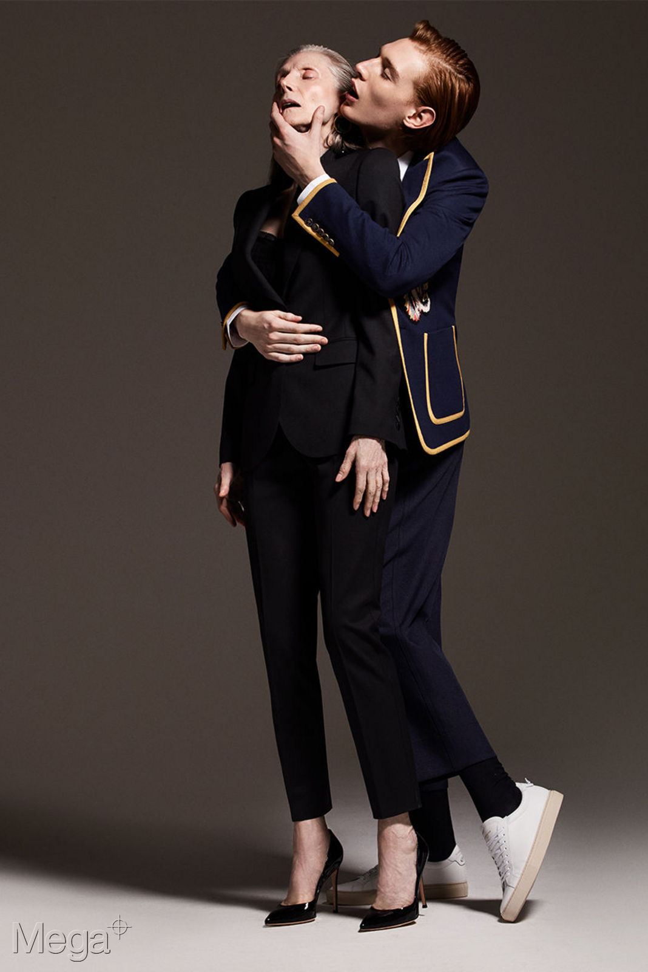


Model – View – ViewModel

Slide 5
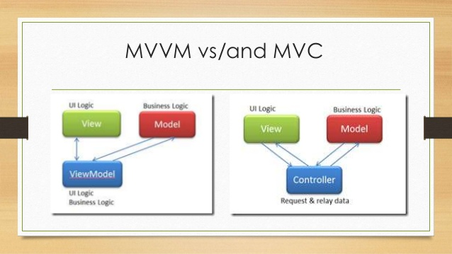
MVVM vs. MVC

Slide 6
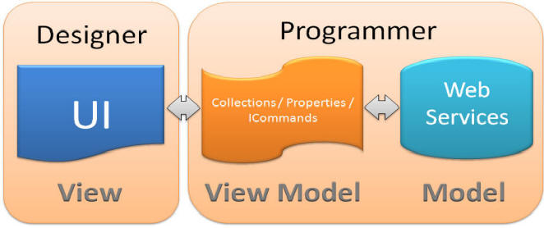
MVVM

Slide 7
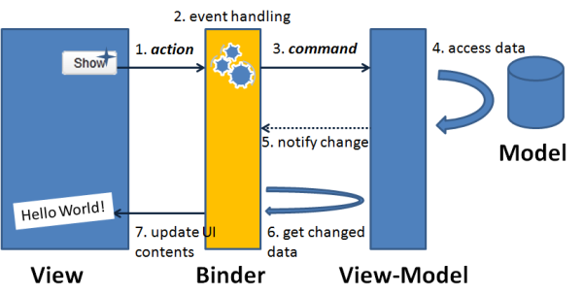
MVVM

Slide 8
MVVM for Mobile and Desktop
Xamarin.Forms
Android
iOS
UWP
Mac.Os
WPF
GTK
Tizen
Many more

Slide 9
Demo

Slide 10
Thanks!

